Slide 1
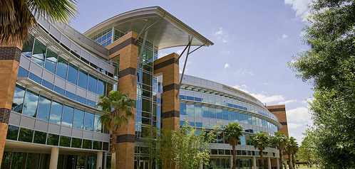
Group 3: DeepGate
Lindsay Davis, EE
Estella Gong, CpE
Michael Lopez-Brau, EE
Cedric Orban, EE

Slide 2
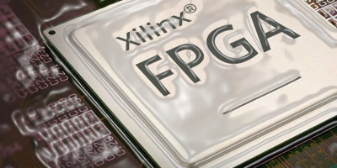
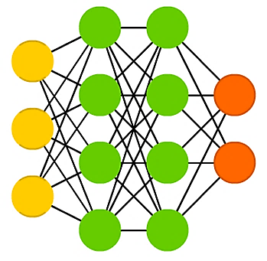
Motivation: FPGA + Deep Learning
Notes:
Active Research Area
Low-power
Reconfigurable
Reprogrammable
Relatively unexplored
Utilizes Our Existing Skills
Microsoft Catapult
“Moonshot project”
Using hardware not affected by decreasing improvement as predicted by Moore’s Law
Huge Success – Enhanced Bing and Azure Products
Google Tensor Processing Unit
Custom ASICs for machine learning

Slide 3
Deep Learning
14 Word Vocabulary (#’s, Directions)
FPGA
DeepGate:
Hardware-Accelerated Speech Recognition System
Off-Chip Training, On-Chip Classification
Interactive Graphical User Interface
Low-Cost, Low-Power

Slide 4
Goals and Objectives
“I think a lot of people don’t know what FPGAs are capable of.” – Derek Chiou, Head of Microsoft Azure Cloud Silicon Team
Process speech audio data fast enough for real-time recognition
Implement deep neural network algorithm on a low cost FPGA
Implement Serial communication Protocol with a high data transfer Rate
Implement GUI to allow for testing Integer and Cardinal Direction speech recognition
Minimize power consumption/cost

Slide 5
Roles & Responsibilities
P = Primary
S = Secondary
Lindsay Davis (P), Cedric Orban (S)
PCB Design
Hardware Interface
Estella Gong (P), Michael Lopez-Brau (S)
User Interface Design
Application Integration
Michael Lopez-Brau (P), Estella Gong (S)
Pre-Processing Algorithms
Deep Learning Algorithms
Cedric Orban (P), Lindsay Davis (S)
FPGA Firmware Programming
Hardware Integration & Communication

Slide 6
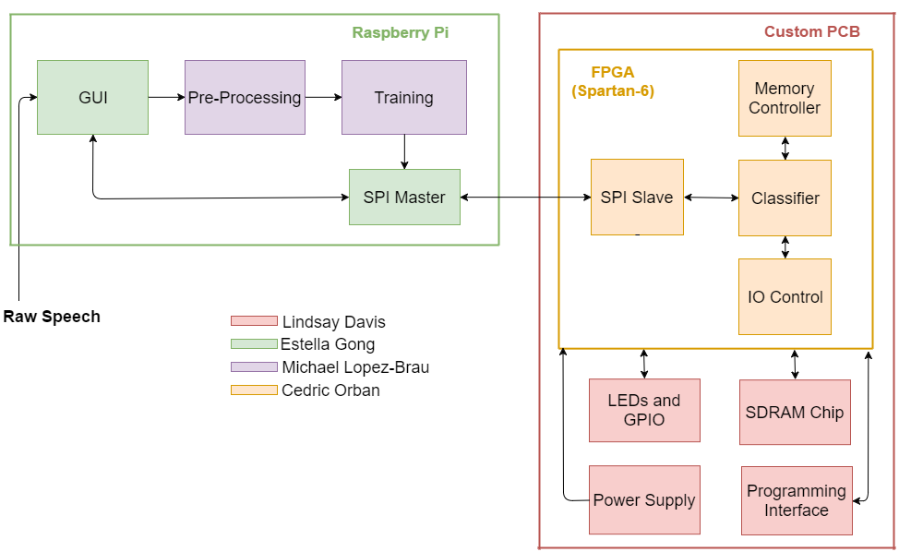
SYSTEM Block Diagram

Slide 7
Approach
Research
Development
Testing
Audio
GUI
PCB Design
Neural Networks
PCB/FPGA
Hardware
Software
E
Notes:
Ouur workflow 3 step process
Not nknowing drones big pic, tech nical details, detail solution

Slide 8
User Interface Design
Estella Gong, CpE

Slide 9
Application: Overview
Front End
Qt GUI
Monitor + Peripherals
Back End + Hardware
Deep Learning Algorithms
Raspberry Pi
PCB/FPGA
Notes:
Allows the user to easily interact with the system
Explain Design Choices

Slide 10


Application: Development
Qt Creator
PyQt
Cross-Platform
Ubuntu VM
Raspberry Pi
OS: Raspbian Jessie
Standard OS for Raspberry Pi
Highly Documented
Linux Based
Communicate via SPI
Synchronous Interface
Supports chain of multiple devices
Fast data rates (20MHZ) and more on FPGA
Notes:
Handy with Ubuntu Libraries
Supports C++ and Python
Recommended for designing GUI’s for the Raspberry Pi
Cross Platform
Wide selection of libraries
Toolkit simplifies UI processing

Slide 11
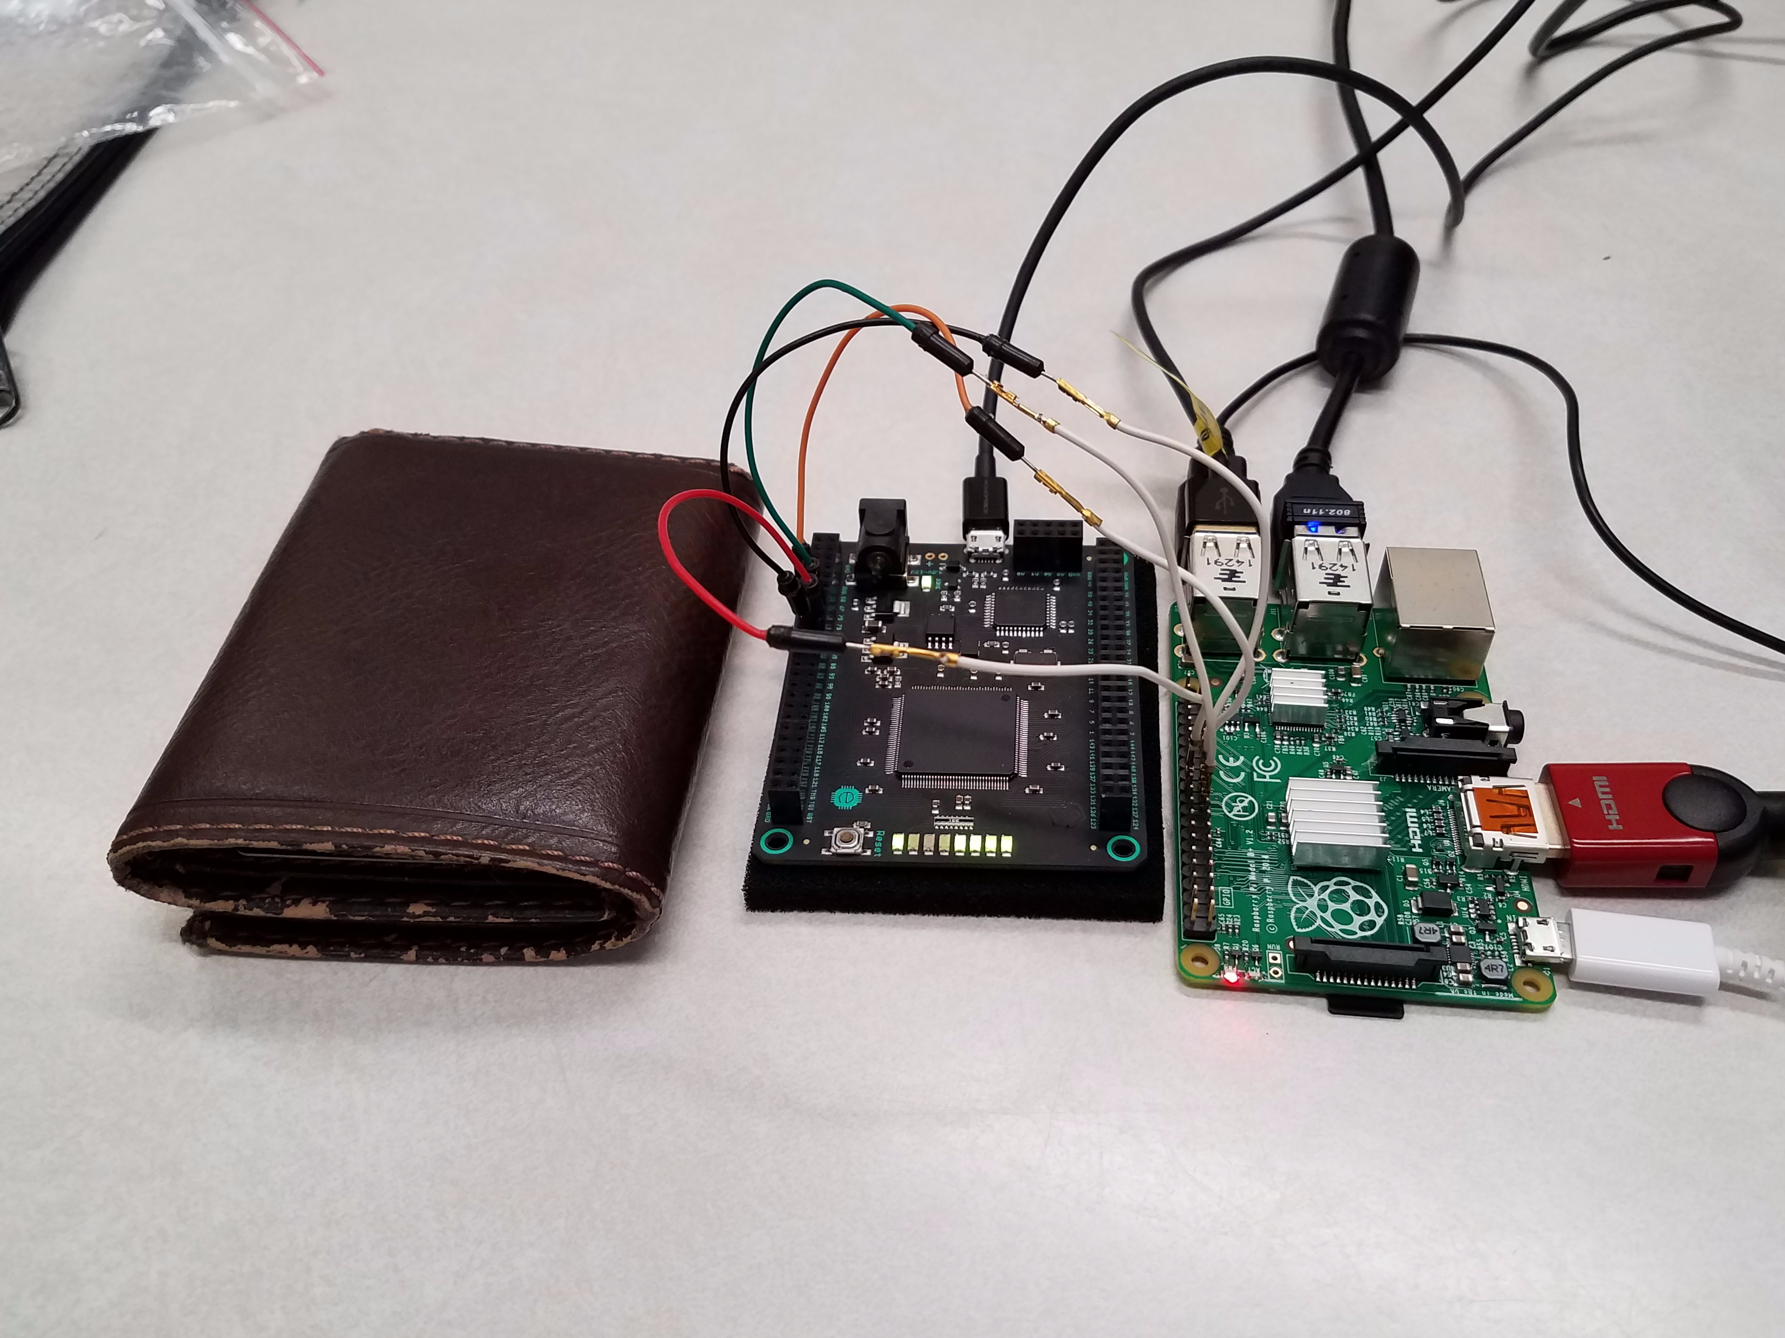
Raspberry Pi
Peripherals
Microphone
Keyboard
Mouse
Advantages:
Smaller, more compact
Faster data transfer via SPI
Version | Raspberry Pi Model B+
CPU | Broadcom SoC running at 700MHz
RAM | 512MB
Networking | 2.4 GHz 802.11n wireless
Storage | 8 GB microSD
GPIO | 40-pin header
Additional Features | 4 x USB 2.0, HDMI
Notes:
We will be using a Raspberry pI, this will run a GUI application
Communications, I2c and choice
For the data we need.
DB9 on the PC transfers 1 bit at a time
Raspberry pi -> GUI

Slide 12
User Interface: Functionality
Input
Network/FPGA
Output
Open WAV file
Record Audio
Show Waveforms
Initialize
Training
Testing
Program FPGA
Generating Weights
Uploading Weights
Classify
User Feedback
Save Log File
Recognized Speech
Audio WAV
Accuracy Meter

Slide 13
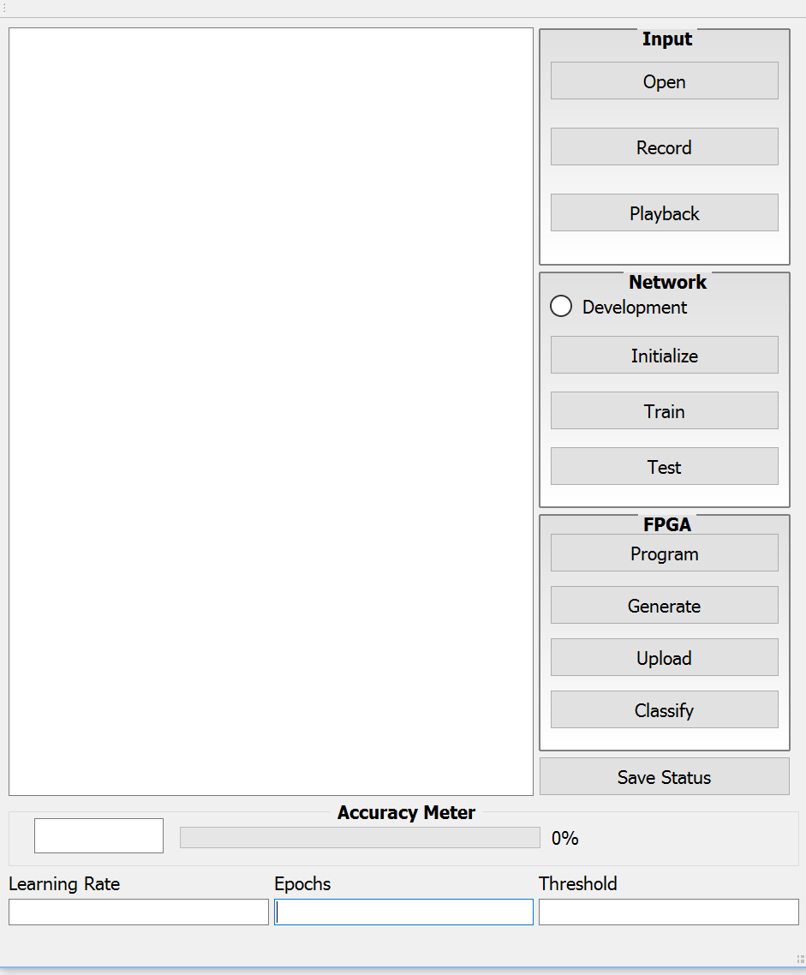

Graphical User Interface: System Mapping

Slide 14
GUI: Features WalkThrough

Slide 15
GUI: Features WalkThrough
Displays Status/Feedback to User

Slide 16
GUI: Features WalkThrough
Obtain Input from User:
Select Existing File
Record audio
Play a recording

Slide 17
GUI: Features WalkThrough
Deep Learning:
Development Mode
Testing using samples from training set
Verify learning
Initialize
Creates instance of NN
Pre-Processes Training/Testing Data
Trains Network
Tests Network

Slide 18
GUI: Features WalkThrough
FPGA Communication:
Programs FPGA
Writes NN
Generate weights file
Upload weights
Upload recording
Classify speech

Slide 19
GUI: Features WalkThrough
Saving Status Display:
Outputs log text file
Clears status display

Slide 20
GUI: Features WalkThrough
Accuracy Meter:
Shows classified word
Progress bar updates to associated performance.

Slide 21
GUI: Features WalkThrough
Edit Arguments:
Learning Rate
Parameter for training the network
Epochs
# of times to train the network on a given data set
Threshold
For identifying start of speech signal.

Slide 22
Deep Learning
Michael Lopez-Brau, EE

Slide 23
Algorithm Design Choice
Deep Feed-Forward
Recurrent Neural Network
Hidden Markov Models
Pros:
Least computationally expensive
Cons:
Data-hungry
Pros:
More effective for time-series data
Cons:
Data-hungry
Computationally expensive
Challenging to develop
Pros:
State-of-the-Art for speech recognition
Cons:
Computationally expensive
Challenging to develop
VS.
VS.

Slide 24
Initialization
First we apply pre-emphasis to the signal
We split up the signal into frames and analyze them (i.e., compute their MFCCs) separately
The resulting set of MFCCs is stitched together and used as input into our network

Slide 25
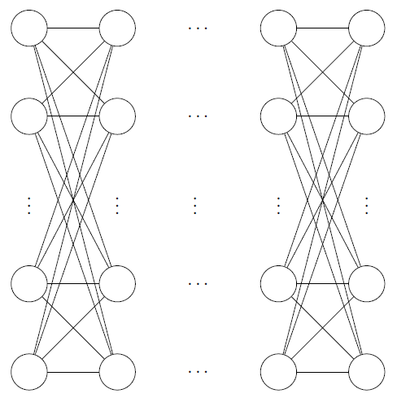
Network Architecture – Overview
Input layer
Hidden layer(s)
Output layer
Data in
Data out

Slide 26
Network Architecture
Input layer: 561 nodes representing the feature vector for a given speech signal
Hidden layer 1: 100 nodes
Hidden layer 2: 50 nodes
Output layer: 14 nodes representing our each word in our vocabulary

Slide 27
Network Constraints
Nodes will be represented by an 8-bit number
Weights will store a 3-bit number
Activation function will be approximated via a combinational approximation
Number and size of hidden layers limited by FPGA plus SDRAM storage

Slide 28
Information Pipeline and processing
Accept Speech
Preprocess
FPGA
Raspberry Pi
Peripherals
Ground Truth
Classifier
Mode
Generate Examples
Train Network
Obtain Result

Slide 29
PCB Design
Lindsay Davis, EE

Slide 30
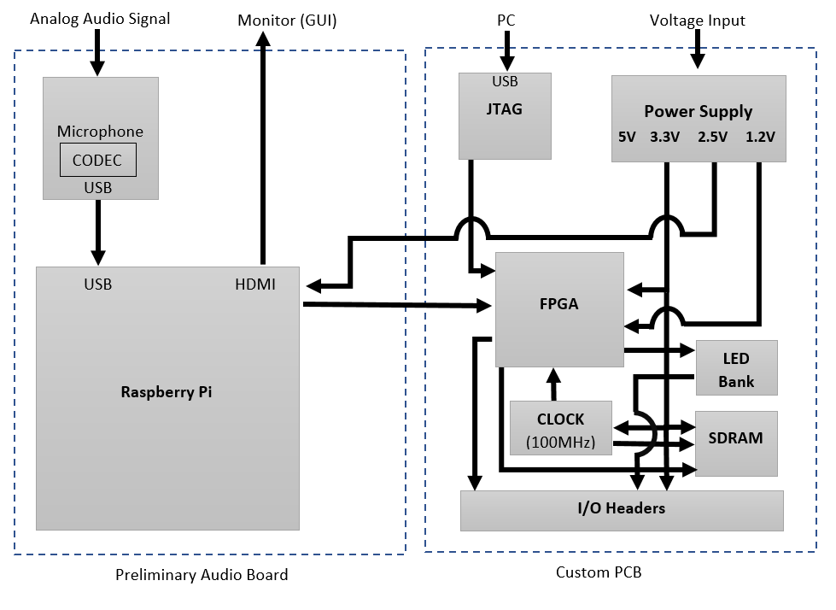
PCB Design - overview

Slide 31
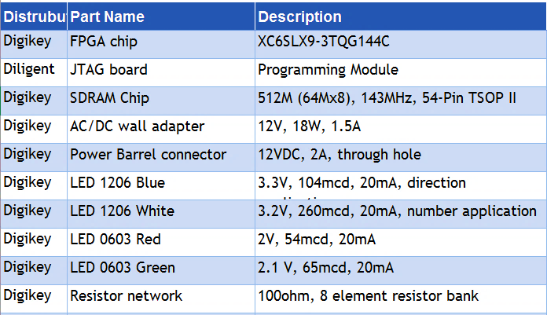
Component Table

Slide 32
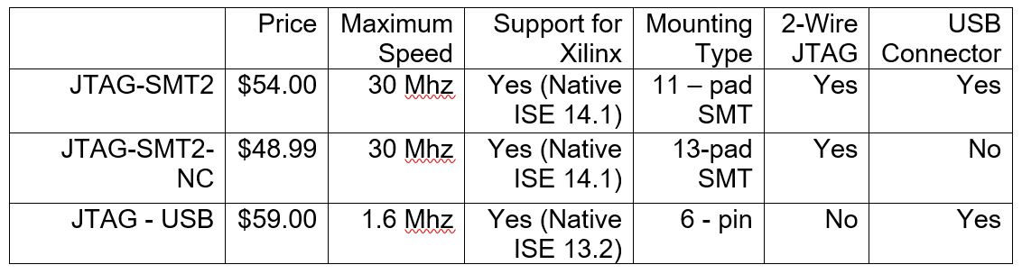
FPGA PROGRAMMING CHIP
Decided between non-programmable options for programming the FPGA

Slide 33
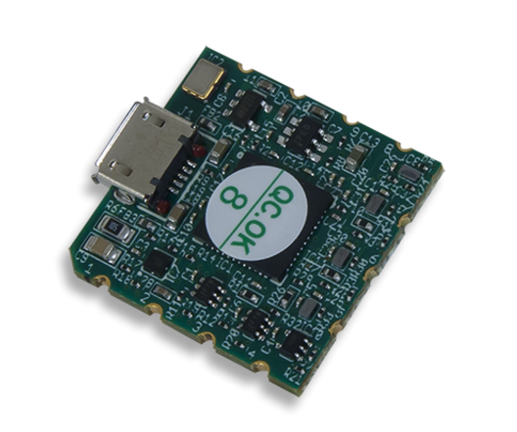
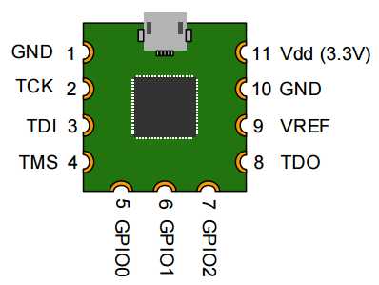
JTAG
Needed to program the FPGA
No programming the module unlike a microcontroller
Surface mount and small
Predesigned FPGA programming module
Micro usb input from PC
Microcontroller needs clock

Slide 34
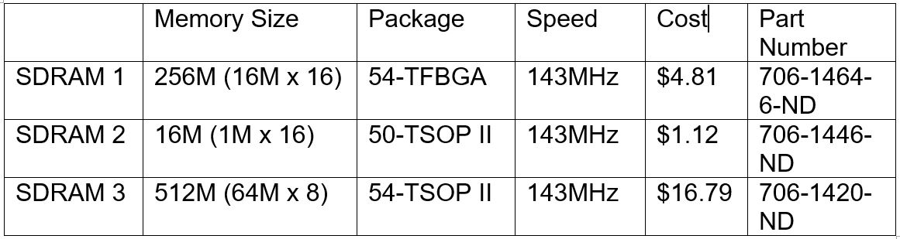
SDRAM Choice
Depended on how much memory was needed and cost

Slide 35
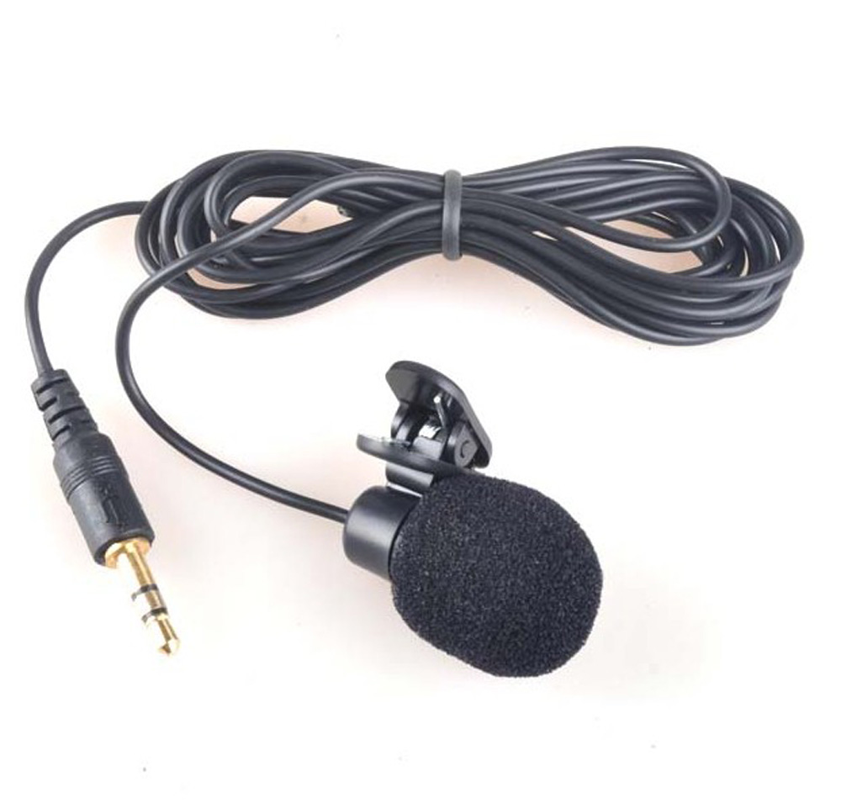
Microphone Choice
Microphone with 3.5mm jack
Connected to an audio analog to digital converter
Connected to Raspberry Pi USB port
Benefits:
Sound quality
Hold the microphone
Higher conversion quality

Slide 36
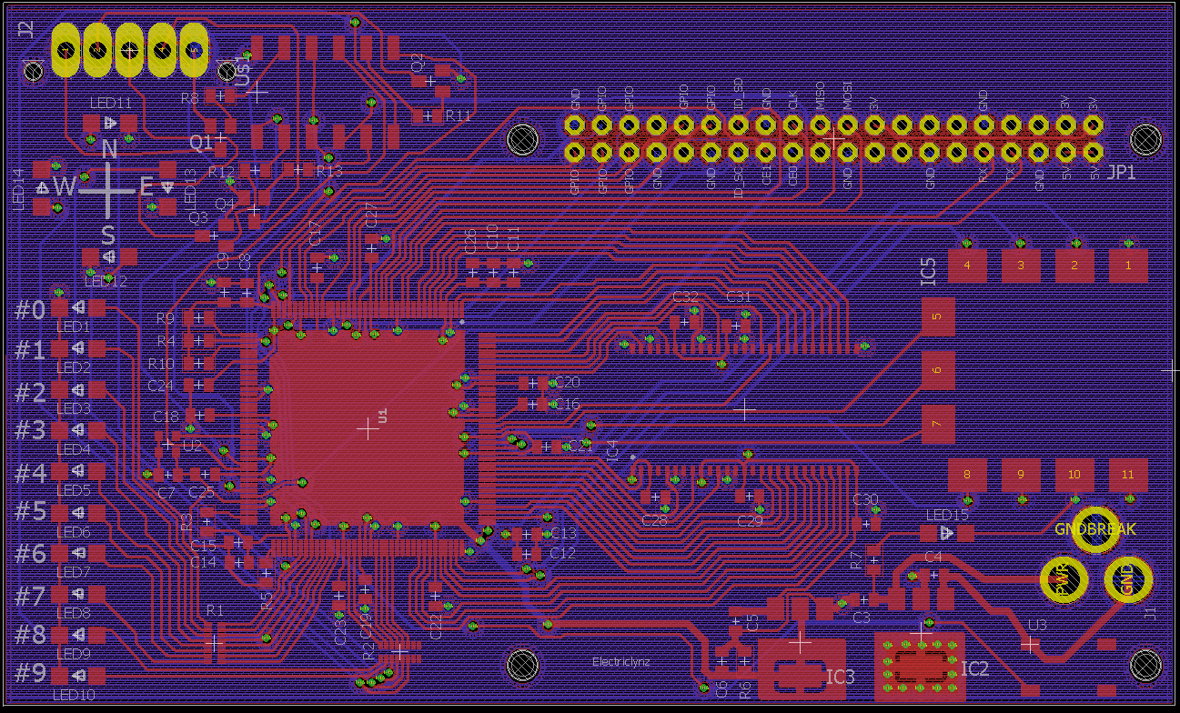
Board Layout Design

Slide 37
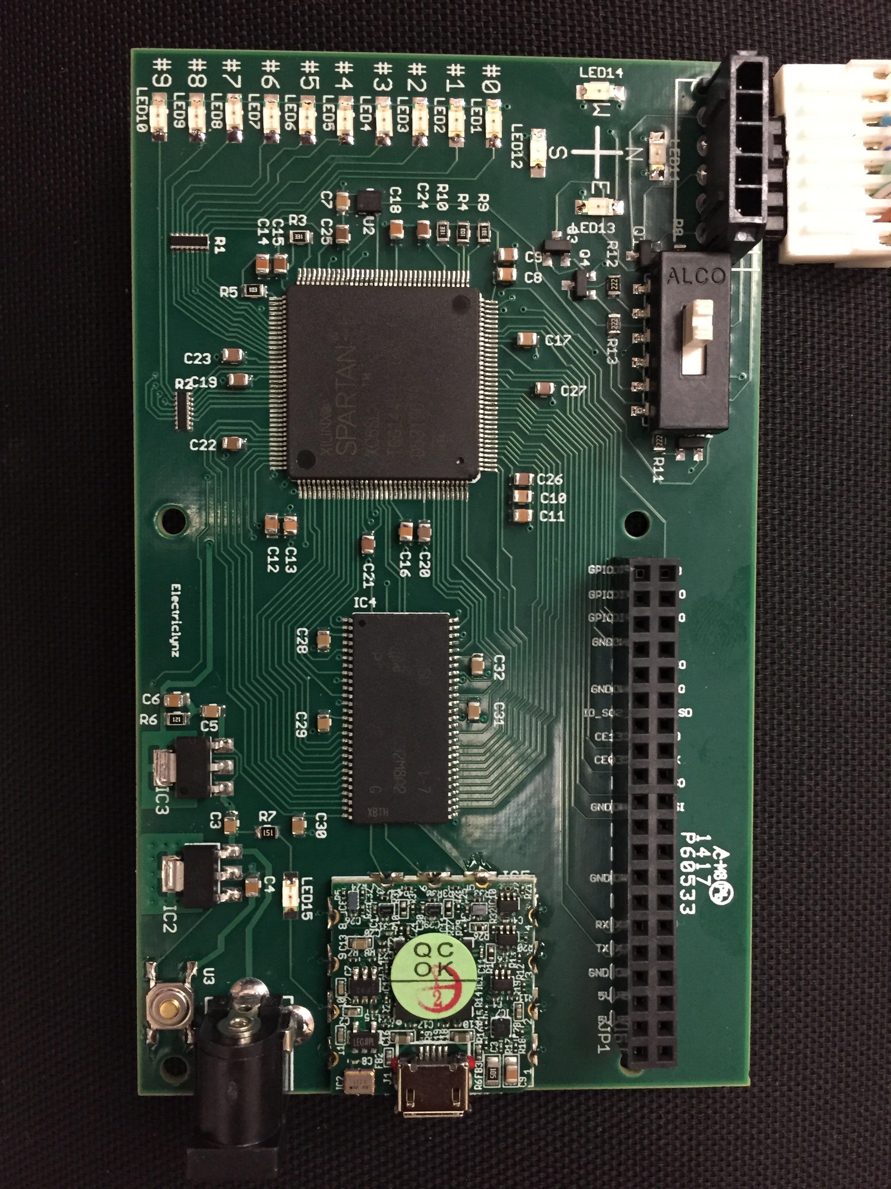
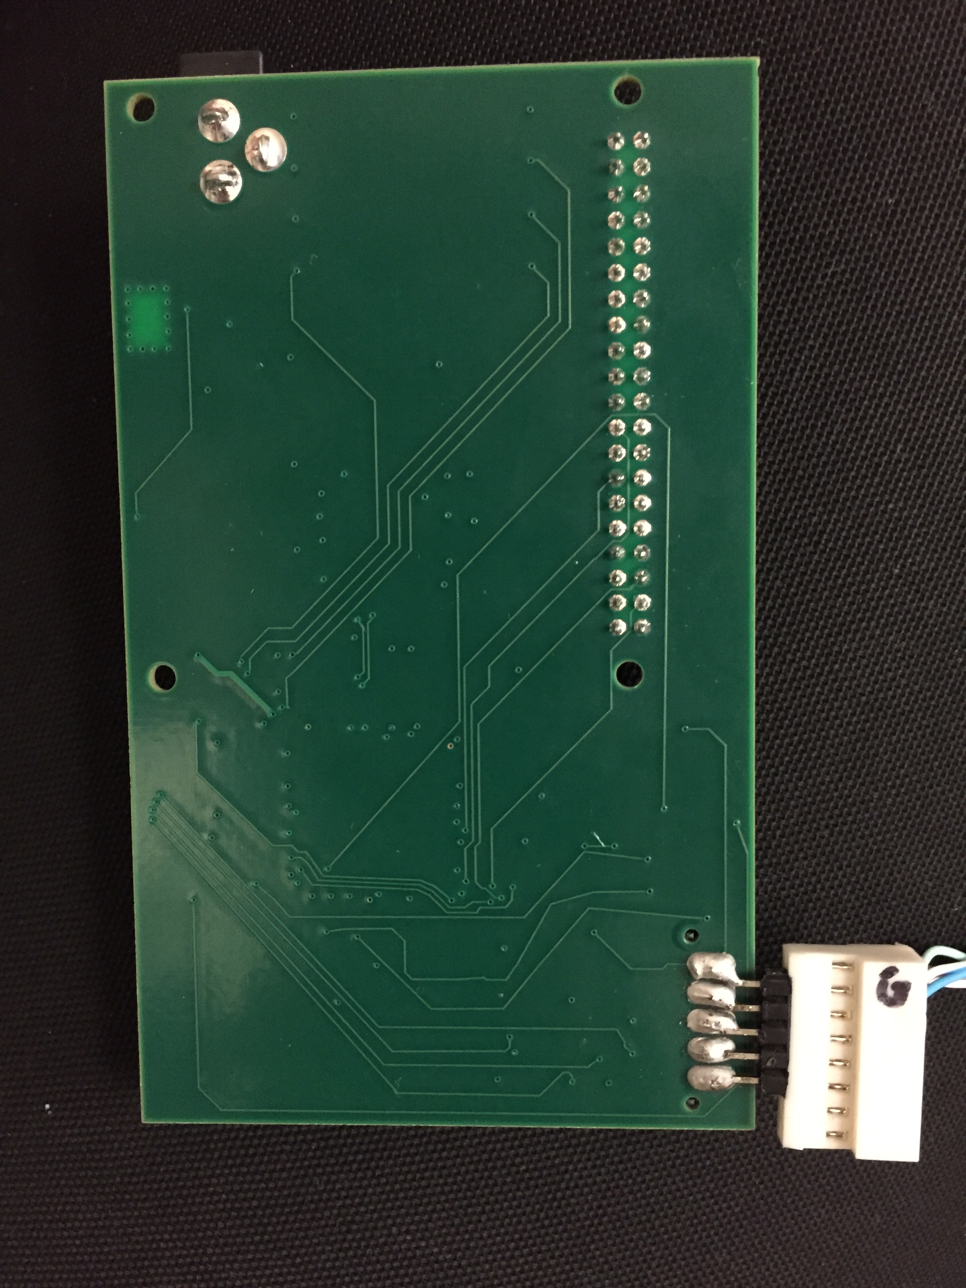
Board Layout
LED Applications
cv
Power Connector
FPGA
SDRAM
RPi Breakout
RC Connector
JTAG

Slide 38
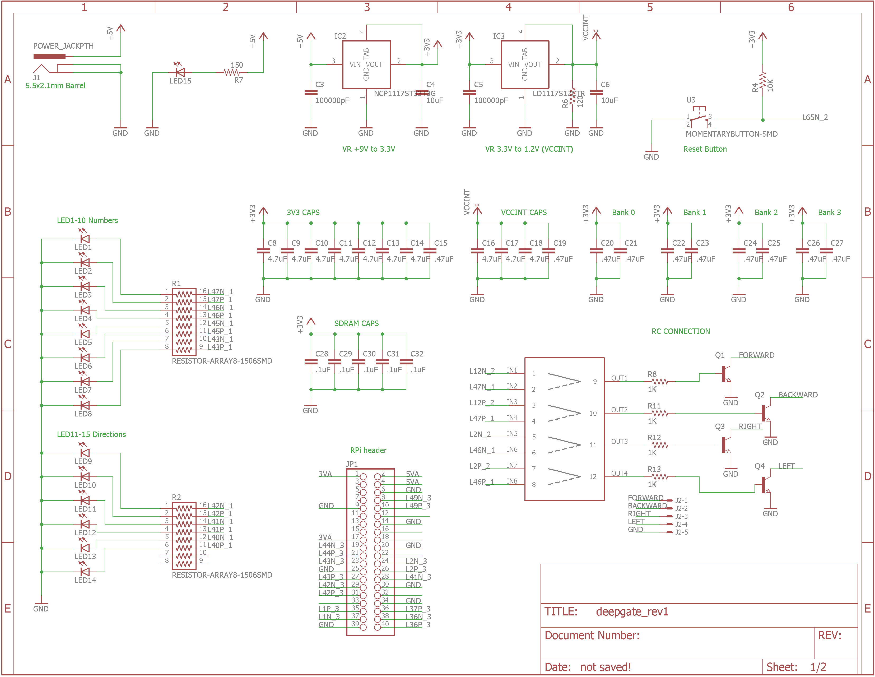
Schematic Page one

Slide 39
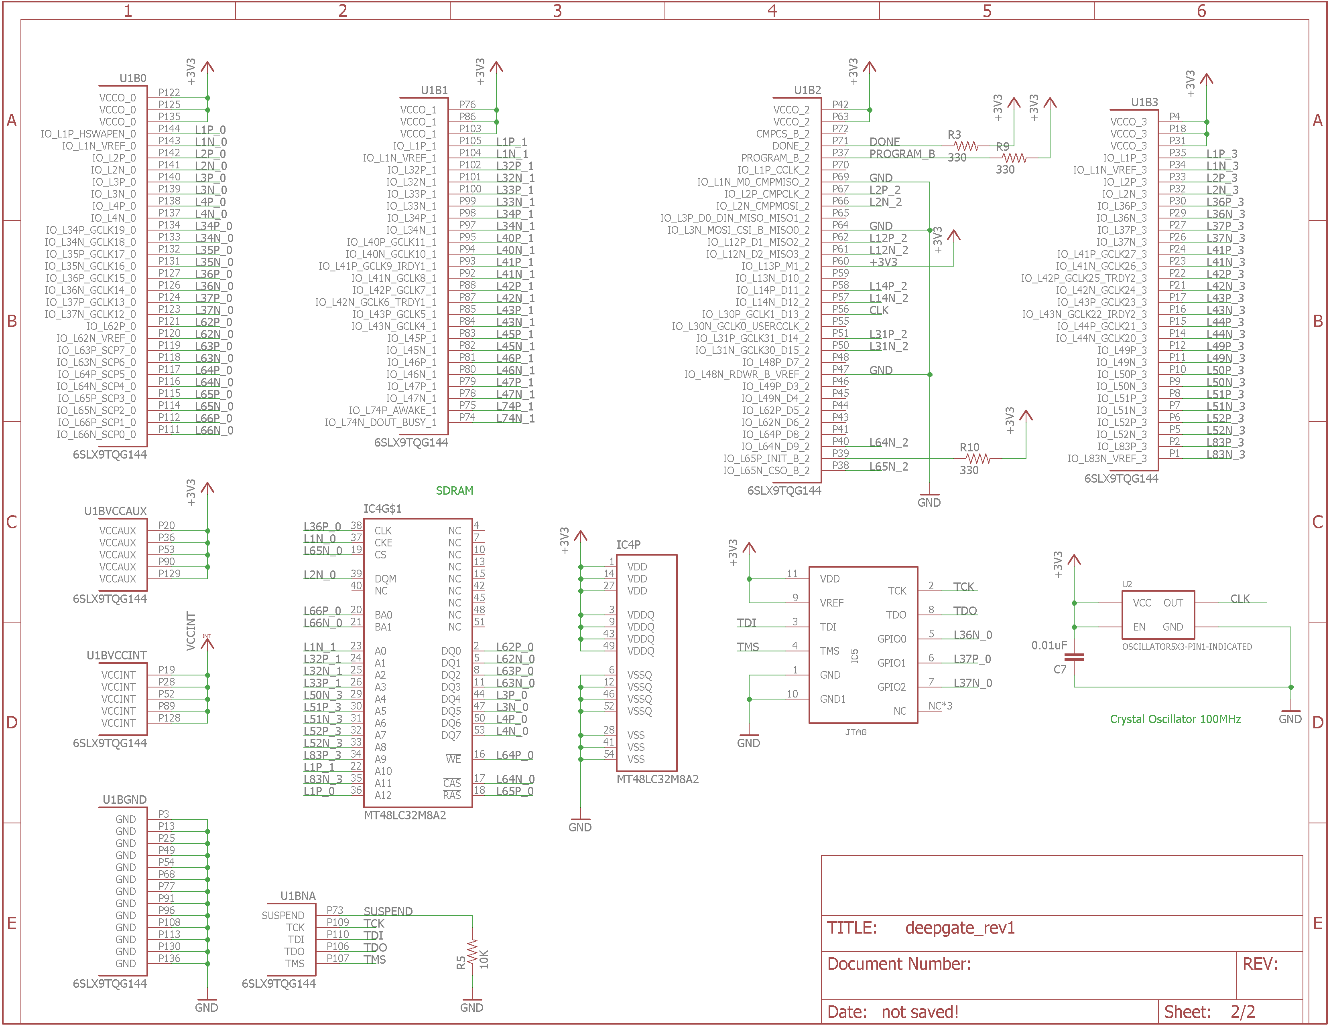
Schematic Page Two

Slide 40
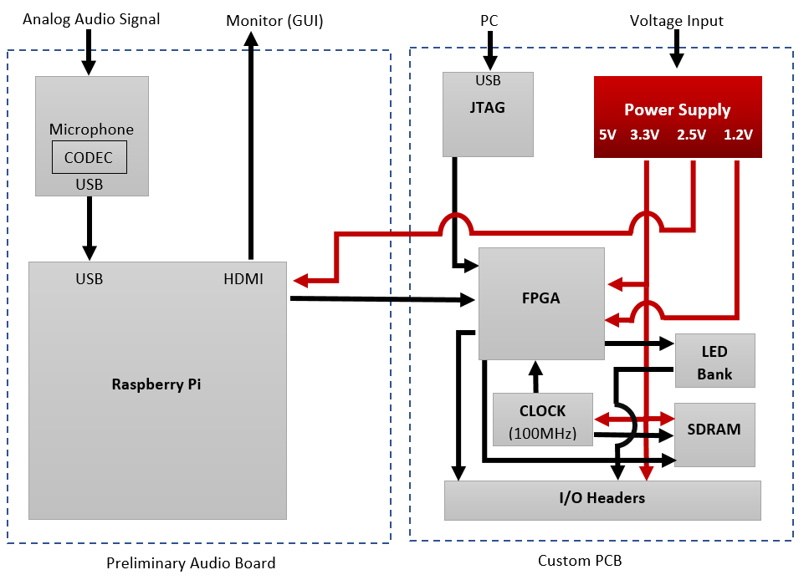
Power - Overview

Slide 41
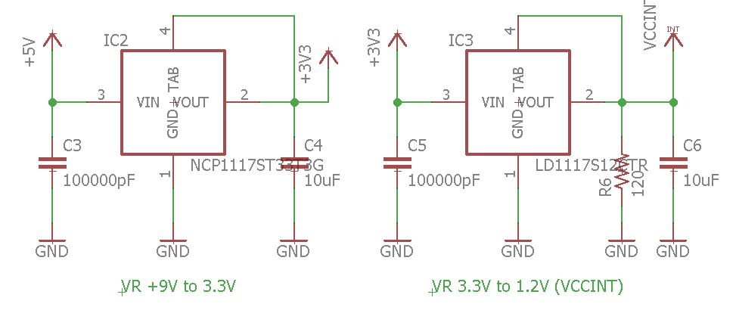
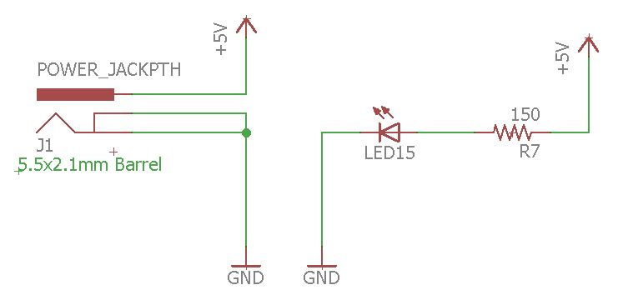
Power
Power LED
5V supply
2V Drop
150 Ohm Resistor
Voltage Regulators
Decoupling capacitors
Two voltage regulators
3.3V
1.2V

Slide 42
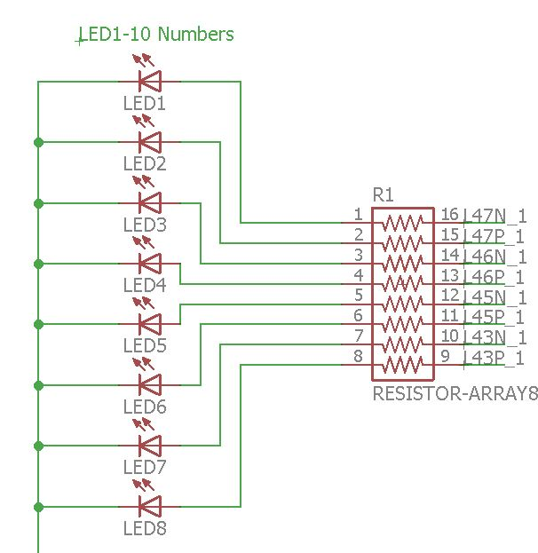
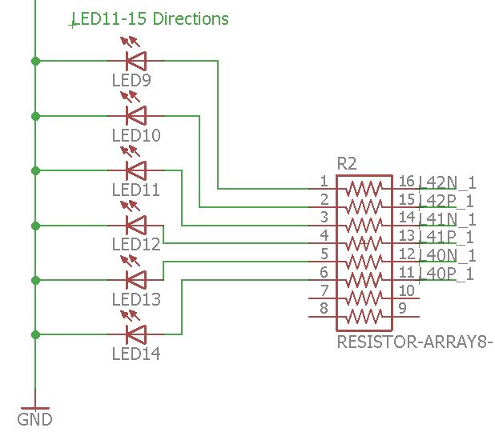
LED Bank
Application LED
Green
1206 pad size
2V @ 20mA
Board LED
Power LED
Resistor bank
8 Array
68 Ohm
Designed with
Ohm’s Law
Kirchhoff's Current Law

Slide 43
FPGA Implementation
Cedric Orban, EE

Slide 44
FPGA Selection
CHIP | Kintex-7 XC7K160T | Spartan-6 XC6SLX75 | Spartan-6 XC6SLX9
Slices | 25,350 | 11,662 | 1,430
On-Chip Block RAM | 11,700 Kb | 3,096 Kb | 576 Kb
Packaging | Ball-Grid Array | Ball-Grid Array | Quad-Flat Package
Development Suite | Free | Free | Free
Development Board | No | No | Yes
Cost | $373.10 | $133.90 | $20.86

Slide 45
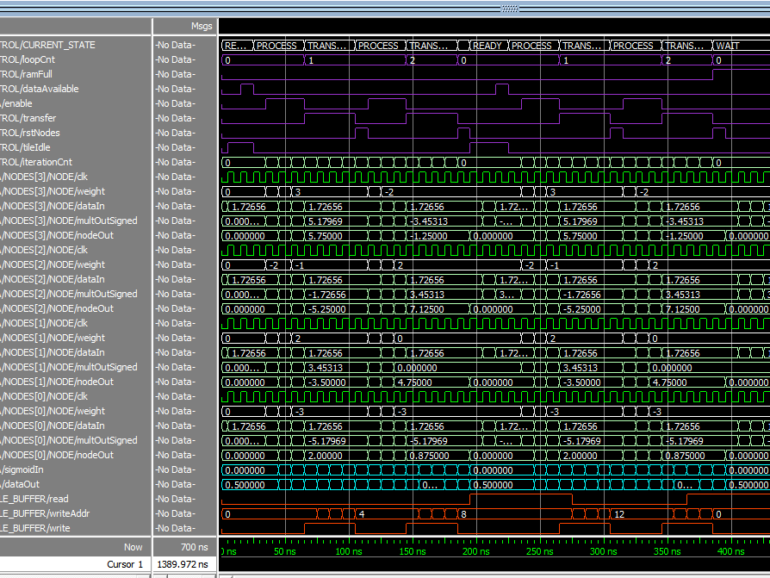
Firmware: constraints
Logic Utilization
Small On-Chip Memory
SDRAM Bandwidth
Arbitrary Network Parameters

Slide 46
Firmware: features
Pipelined
Modifiable Area/Latency Trade-off
High-Precision Sigmoid Activation Function
Reduced Weight Width (3-bit, 4-bit, 5-bit)
Non-Linear Weight Distribution
Arbitrary Neural Network Size

Slide 47
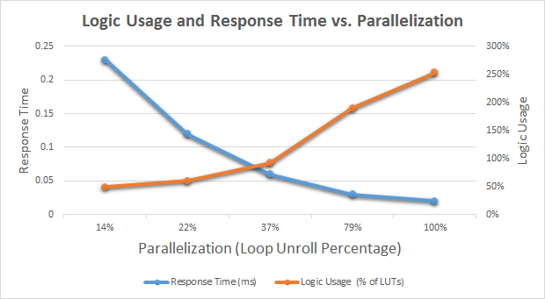
Performance Metrics I

Slide 48
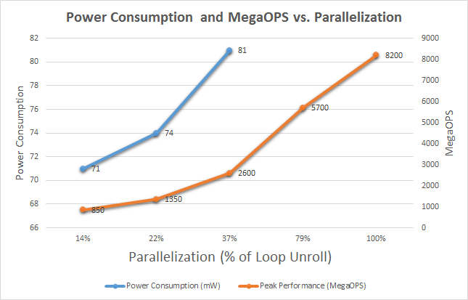
Performance Metrics II

Slide 49
Architecture Overview – Overall

Slide 50
Firmware: Analysis
Fast enough for real-time classification
Logic usage can be further reduced
Constraints led to minimal accuracy loss
Severely memory bandwidth limited

Slide 51
Integration & Test
Subsystem Level
Consolidate
DeepGate System
Deep Learning Algorithms
PCB
FPGA
Graphical User Interface
Divide & Conquer

Slide 52
Unforeseen Challenges
Problem | Solution
Data Transfer Rate | PC (DB 9) → Raspberry Pi
Incompatible SPI Libraries | RPi3 Model B → RPi2 Model B+
PCB Flaws | Solder

Slide 53
Financing
Part | Cost
Development Board | $35.23
PCB Components | $99.71
PCB Manufacturing | $100.93
PCB Assembly/Shipping | $30.00
Raspberry Pi 3 | $50.00
Peripherals/Accessories | $52.64
Administrative | $25.00
Total | $393.49
Sponsor | Amount
SoarTech | $1000

Slide 54
Thank you So much!
Group 3

